Slide 1
JavaScript Operators
David Tarvin, AIM Code School

Slide 2
JavaScript Operators - What are they?
An operator is something that is capable of manipulating a value
The value being manipulated is called an operand
JavaScript operators are used to assign values, compare values, perform arithmetic operations, and more

Slide 3
JavaScript Operators - Types
Arithmetic
Assignment
String
Comparison
Conditional (Ternary)
Logical
Bitwise
typeof
delete
in
instanceof
void

Slide 4
Categories of Operators
Unary - operators that take one value
Binary - operators that take two values
Ternary - operators that take three values

Slide 5
Unary Operators
Unary Plus (+) | Converts to a number
Unary Negation (-) | Converts to a number and negates
Unary Increment (++) | Adds one to the operand
Unary Decrement (--) | Subtracts one from the operand

Slide 6
Unary Operators (cont’d)
Logical NOT (!) | Negates the boolean value of an operand
Bitwise NOT (~) | Inverts all the bits of its operand
typeof | Returns the data type of its operand as a string
delete | Removes a property from an object
void | Evaluates a given expression and returns undefined

Slide 7
Unary Plus (+) and Unary Negation (-)
Both precede the operand
Unary plus evaluates to its operand
Unary negation negates its operand
If operand is not a number, first attempts to convert operand to a number
Can convert all string representations of numbers, boolean values, and null
Numbers include integers, floats, hexadecimal, scientific (exponent) notation, and Infinity
If the operand cannot be converted to a number, the unary plus operator returns NaN

Slide 8
Unary Plus (+)
Operation | Result | Operation | Result
+3 | 3 | +true | 1
+”3” | 3 | +false | 0
+”-3” | -3 | +null | 0
+”3.14” | 3.14 | +”Infinity” | Infinity
+”123e-5” | 0.00123 | +”not a number” | NaN
+”0xFF” | 255 | +function(val){return val} | NaN

Slide 9
Unary Negation (-)
Operation | Result | Operation | Result
-3 | -3 | -true | -1
-”3” | -3 | -false | 0
-”-3” | 3 | -null | 0
-”3.14” | -3.14 | -”Infinity” | -Infinity
-”123e-5” | -0.00123 | -”not a number” | NaN
-”0xFF” | -255 | -function(val){return val} | NaN

Slide 10
Increment (++) and Decrement (--)
Increment adds 1 to the operand and returns a value
Decrement subtracts 1 from the operand and returns a value
If the increment operator comes before the operand (prefix), the value returned is the value after incrementing
If the increment operator comes after the operand (postfix), the value returned is the value before incrementing

Slide 11
JavaScript Increment and Decrement (cont’d)
Operator | Description | Example (y = 5) | Result in y | Result in x
++ | Increment | x = ++y | y = 6 | x = 6
 |  | x = y++ | y = 6 | x = 5
-- | Decrement | x = --y | y = 4 | x = 4
 |  | x = y-- | y = 4 | x = 5

Slide 12
Logical NOT (!)
The logical NOT (!) operator turns truth to falsity and vice versa
Operation | Result | Operation | Result
!false | true | !NaN | true
!0 | true | !null | true
!undefined | true | !”” | true
!-3 | false | !”-3” | false

Slide 13
Logical NOT (!) (cont’d)
The logical NOT (!) operator turns truth to falsity and vice versa
Operation | Result | Operation | Result
!42 | false | !”42” | false
!”string” | false | !”true” | false
!”false” | false | !{} | false
![] | false | !function(){} | false

Slide 14
Double negation (!!)
Can be used to turn strings and other data types into boolean values
!!”Hi” === true // returns true
First, a negation of a string returns false:
!”Hi” // returns false
Then, a negation of false returns true:
!false // returns true
Thus:
true === true //returns true

Slide 15
Bitwise NOT (~)
The bitwise NOT operator (~) inverts the bits of its operand
A bitwise not on a number results in -(x + 1)
a | NOT a
0 | 1
1 | 0

Slide 16
Bitwise NOT (cont’d)
Operation | Result | Operation | Result
~3 | -4 | ~true | -2
~”3” | -4 | ~false | -1
~”-3” | 2 | ~null | -1
~”3.14” | -4 | ~”Infinity” | -1
~”123e-5” | -1 | ~”not a number” | -1
-”0xFF” | -256 | -function(val){return val} | -1

Slide 17
Bitwise NOT (cont’d)
(base 10) | (base 2) | NOT (base 2) | NOT (base 10)
2 | 00000010 | 11111101 | -3
1 | 00000001 | 11111110 | -2
0 | 00000000 | 11111111 | -1
-1 | 11111111 | 00000000 | 0
-2 | 11111110 | 00000001 | 1
-3 | 11111101 | 00000010 | 2

Slide 18
typeof
The typeof operator returns a string indicating the data type of the unevaluated operand
Operation | Result | Operation | Result
typeof 3 | ‘number’ | typeof ‘3’ | ‘string’
typeof -3 | ‘number’ | typeof 3.14 | ‘number’
typeof 123e-5 | ‘number’ | typeof 0xFF | ‘number’
typeof true | ‘boolean’ | typeof false | ‘boolean’
typeof null | ‘object’ | typeof Infinity | ‘number’

Slide 19
typeof
Operation | Result | Operation | Result
typeof NaN | ‘number’ | typeof [1,2,3] | ‘object’
typeof Date() | ‘string’ | typeof new Date() | ‘object’
typeof undefined | ‘undefined’ | typeof {hi: “world”} | ‘object’
typeof function(val){return val} | ‘function’
typeof {valueOf: function(){return ‘0xFF’}} | ‘object’

Slide 20
Binary Operators - Arithmetic
Arithmetic operators are used to perform arithmetic between variables and/or values
Operator | Description | Example (y = 5) | Result in y | Result in x
+ | Addition | x = y + 2 | y = 5 | x = 7
- | Subtraction | x = y - 2 | y = 5 | x = 3
* | Multiplication | x = y * 2 | y = 5 | x = 10
/ | Division | x = y / 2 | y = 5 | x = 2.5
% | Modulus (Remainder) | x = y % 2 | y = 5 | x = 1

Slide 21
Binary Operators - Assignment
Assignment operators are used to assign values to JavaScript variables.
Operator | Example (x = 10, y = 5) | Same As | Result in x
= | x = y | x = y | x = 5
+= | x += y | x = x + y | x = 15
-= | x -= y | x = x - y | x = 5
*= | x *= y | x = x * y | x = 50
/= | x /= y | x = x / y | x = 2
%= | x %= y | x = x % y | x = 0

Slide 22
JavaScript String Operators
The + operator and the += operator can also be used to concatenate (add) strings.
Given that text1 = “Good “, text2 = “Morning”, and text3 = “”:
Operator | Example | text1 | text2 | text3
+ | text3 = text1 + text2 | “Good “ | “Morning” | “Good Morning”
+= | text1 += text2 | “Good Morning” | “Morning”

Slide 23
Binary Operators - Comparison
Comparison operators are used in logical statements to determine equality or difference between variables and values
Operator | Description | Comparing (x = 5) | Returns
== | equal to | x == 8 | false
 |  | x == 5 | true
=== | equal value and equal type | x === “5” | false
 |  | x === 5 | true
!= | not equal | x != 8 | true
!== | not equal value or not equal type | x !== “5” | true
 |  | x !== 5 | false

Slide 24
Binary Operators - Comparison (cont’d)
Operator | Description | Comparing (x = 5) | Returns
> | greater than | x > 8 | false
< | less than | x < 8 | true
>= | greater than or equal to | x >= 8 | false
<= | less than or equal to | x <= 8 | true

Slide 25
JavaScript Conditional (Ternary) Operator
The conditional operator assigns a value to a variable based on a condition
Syntax: variablename = (condition) ? value1 : value2;
Example: votable = (age < 18) ? “Too young” : “Old enough”;

Slide 26
JavaScript Logical Operators
Logical operators are used to determine the logic between variables or values.
Operator | Description | Example (x = 6 and y = 3) | Result
&& | and | (x < 10 && y > 1) | true
 |  | (x < 8 && y > 4) | false
|| | or | (x > 8 || y < 5) | true
 |  | (x > 10 || y > 4) | false
! | not | !(x == 5) | true
 |  | !(y == 3) | false

Slide 27
JavaScript Logical Operators (cont’d)
With and (&&), JavaScript evaluates the first condition. If it is false, JavaScript doesn’t even review the second condition but automatically declares the entire expression false.
With or (||) JavaScript evaluates the first condition. If it is true, JavaScript doesn’t even review the second condition but automatically declares the entire expression true.

Slide 28
JavaScript Bitwise Operators
Bitwise operators work on 32-bit Bitwise operands
A number in JavaScript is stored as a 64-bit floating point number
To perform a bit-operation, JavaScript:
converts the number into a 32-bit binary number (signed)
Performs the operation
Converts the result back to a 64-bit number

Slide 29
JavaScript Bitwise Operators (cont’d)
Bitwise operators work on 32-bit Bitwise operands
A number in JavaScript is stored as a 64-bit floating point number
To perform a bit-operation, JavaScript:
converts the number into a 32-bit binary number (signed)
Performs the operation
Converts the result back to a 64-bit number

Slide 30
JavaScript Bitwise Operators (cont’d)
Bitwise AND ( & )
Accepts two operands
Compares each bit of the first operand to the corresponding bit of the second operand
If both bits are 1, sets the corresponding result bit to 1
Otherwise, corresponding result bit is set to 0

Slide 31
JavaScript Bitwise Operators (cont’d)
Bitwise AND ( & ) Truth Table
A | B | Output (A & B)
0 | 0 | 0
0 | 1 | 0
1 | 0 | 0
1 | 1 | 1

Slide 32
JavaScript Bitwise Operators (cont’d)
Bitwise AND ( & ) examples:
const a = 23; // 10111 in binary const b = 1; // 00001 in binary console.log(a & b); // 1
The bits in the 1 column are both set to 1, while all other bits either have only one bit set to 1 or no bits set to 1, so the result is set as 00001, which is 1 in decimal

Slide 33
JavaScript Bitwise Operators (cont’d)
Bitwise AND ( & ) examples:
const a = 23; // 10111 in binary const b = 6; // 00110 in binary console.log(a & b); // 6
The bits in the 4 column and the 2 column are all set to 1, while all other bits either have only one bit set to 1 or no bits set to 1, so the result is set as 00110, which is 6 in decimal

Slide 34
JavaScript Bitwise Operators (cont’d)
Bitwise AND ( & ) examples:
const a = 23; // 10111 in binary const b = 8; // 01000 in binary console.log(a & b); // 0
None of the columns have both bits set to 1, so the result is 00000, which is 0 in decimal

Slide 35
JavaScript Bitwise Operators (cont’d)
Bitwise OR ( | )
Accepts two operands
Compares each bit of the first operand to the corresponding bit of the second operand
If either bit is 1, sets the corresponding result bit to 1
Otherwise, corresponding result bit is set to 0

Slide 36
JavaScript Bitwise Operators (cont’d)
Bitwise OR ( | ) Truth Table
A | B | Output (A & B)
0 | 0 | 0
0 | 1 | 1
1 | 0 | 1
1 | 1 | 1

Slide 37
JavaScript Bitwise Operators (cont’d)
Bitwise OR ( | ) example:
const a = 17; // 10001 in binary const b = 9; // 01001 in binary console.log(a & b); // 1 console.log(a | b); // 25
There is at least one bit set to 1 in the 16 and 8 columns and both bits set to 1 in the 1 column, so the result set is 11001, which is 25 in decimal

Slide 38
JavaScript Bitwise Operators (cont’d)
Bitwise XOR ( ^ )
Accepts two operands
Compares each bit of the first operand to the corresponding bit of the second operand
If one bit is set to 1, and the other bit is set to 0, sets the corresponding result bit to 1
Otherwise, corresponding result bit is set to 0

Slide 39
JavaScript Bitwise Operators (cont’d)
Bitwise XOR ( ^ ) Truth Table
A | B | Output (A & B)
0 | 0 | 0
0 | 1 | 1
1 | 0 | 1
1 | 1 | 0

Slide 40
JavaScript Bitwise Operators (cont’d)
Bitwise XOR ( ^ ) example:
const a = 17; // 10001 in binary const b = 9; // 01001 in binary console.log(a ^ b); // 24
There is at only one bit set to 1 in each of the 16 and 8 columns, so the result bit is set to 1 in those columns. The remaining columns have both bits set to either 0 or 1, so the result bit in those columns is set to 0. The result set is 11000, which is 24 in decimal.

Slide 41
JavaScript Bitwise Operators (cont’d)
JavaScript bitwise operators can be confusing. You may never deal with them (I never have) unless you get into some very specific types of programming or find yourself in some very specific situations.
Let’s ask ChatGPT!!!

Slide 42
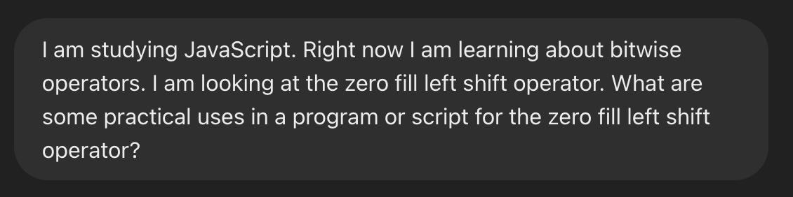
My conversation with ChatGPT

Slide 43
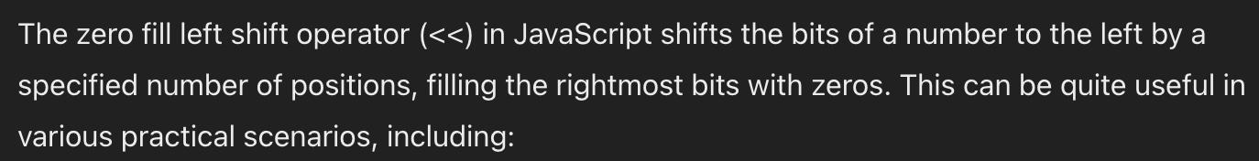
My conversation with ChatGPT (cont’d)

Slide 44
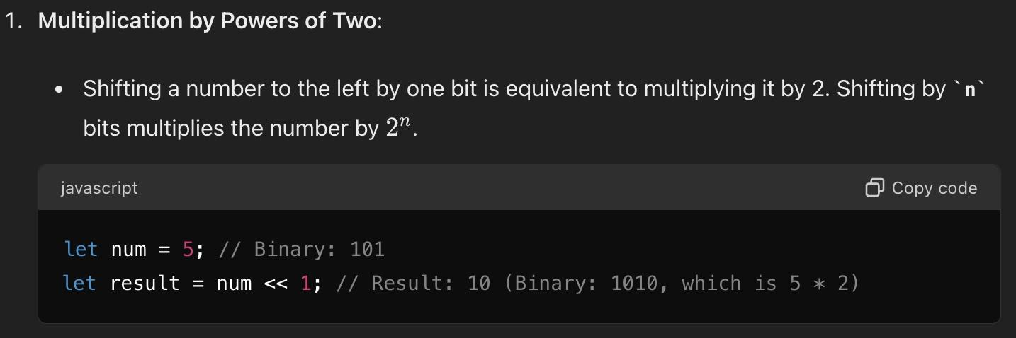
My conversation with ChatGPT (cont’d)

Slide 45
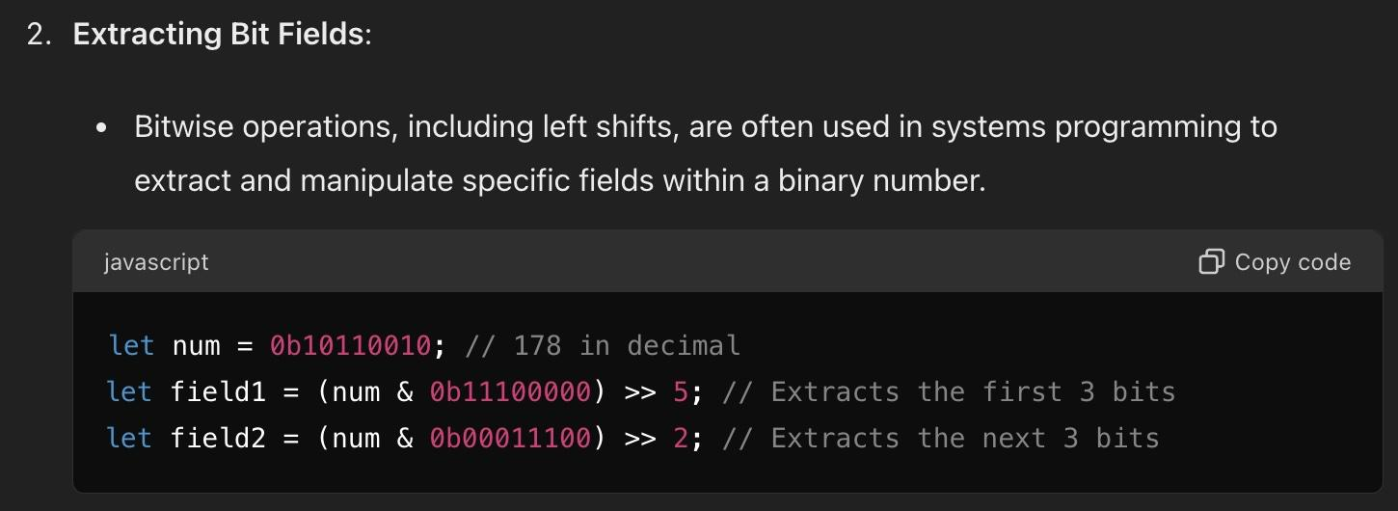
My conversation with ChatGPT (cont’d)

Slide 46
Order of Operator Precedence
Operator precedence describes the order in which operations are performed in an arithmetic expression
Operations with higher precedence are performed before operations with lower precedence
Operations with equal precedence are performed from left to right
The highest level of precedence is parentheses
Any operations in parentheses are conducted before any other operations, even if the operations in parentheses would normally have a lower level of precedence than the other operations

Slide 47
Operator Precedence (cont’d)
Example 1:
x = 5 - 3 + 8
Addition and subtraction have the same level of precedence, so the operations are completed from left to right
5 - 3 = 2 2 + 8 = 10 x = 10

Slide 48
Operator Precedence (cont’d)
Example 2:
x = 5 - (3 + 8)
The operation in parentheses is completed first, then the remaining operation is completed
3 + 8 = 11 5 - 11 = -6 x = -6

Slide 49
Operator Precedence (cont’d)
Example 3:
x = 10 + 15 * 24/ 2 - 8
Multiplication and division have a higher precedence than addition and subtraction, so they are completed first
Multiplication and division have the same preference, so those operations are conducted from left to right
15 * 24 = 360
360 / 2 = 180
Addition and subtraction have the same precedence, so they are completed left to right
10 + 180 = 190
190- 8 = 182
x = 182

Slide 50
Operator Precedence (cont’d)
Example 4:
x = (10 + 15) * ((24 / 2) - 8)
When dealing with nested parentheses, complete the innermost first
24 / 2 = 12
For parentheses on the same level, complete left to right
10 + 15 = 25
12 - 8 = 4
Once parentheses have been dealt with, proceed with completing rest of operation
25 * 4 = 100
x = 100

Slide 51
Operator Precedence (cont’d)
JavaScript Order of Precedence for Operators
Operataor | Operation | Order of Precedence | Order of Evaluation
++ | Increment | First | R -> L
- - | Decrement | First | R -> L
- | Negation | First | R -> L
! | NOT | First | R -> L

Slide 52
Operator Precedence (cont’d)
JavaScript Order of Precedence for Operators
Operataor | Operation | Order of Precedence | Order of Evaluation
*, /, % | Multiplication, division, modulus | Second | L -> R
+, - | Addition, subtraction | Third | L -> R
+ | Concatenation | Third | L -> R
<, <= | Less than, less than or equal to | Fourth | L -> R

Slide 53
Operator Precedence (cont’d)
JavaScript Order of Precedence for Operators
Operataor | Operation | Order of Precedence | Order of Evaluation
>, >= | Greater than, greater than or equal to | Fourth | L -> R
== | Equality | Fifth | L -> R
!= | Inequality | Fifth | L -> R
=== | Strict equality | Fifth | L -> R

Slide 54
Operator Precedence (cont’d)
JavaScript Order of Precedence for Operators
Operataor | Operation | Order of Precedence | Order of Evaluation
!== | Strict inequality | Fifth | L -> R
&& | AND | Sixth | L -> R
|| | OR | Sixth | L -> R
?: | Ternary | Seventh | R -> L
= | Assignment | Eighth | R -> L

Slide 55
Operator Precedence (cont’d)
JavaScript Order of Precedence for Operators
Operataor | Operation | Order of Precedence | Order of Evaluation
+=, -=, etc. | Arithmetic assignment | Eighth | R -> L

Slide 56
References
How to Use JavaScript Unary Operators, Ester Dama Kahindi, DigitalOcean, updated Apr 14, 2021, https://www.digitalocean.com/community/tutorials/javascript-unary-operators-simple-and-useful, accessed May 25, 2024.

